Slide 1
Structure Function and the EMC effect of the Deuteron
Mike Nycz

Slide 2
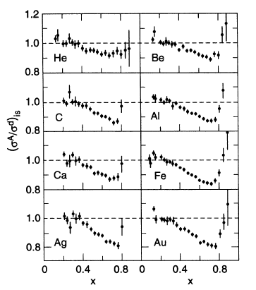
The EMC effect
Modification of nucleon properties in the nuclear medium
EMC effect is reported as the isoscalar ratio of heavy nuclei to Deuterium, per nucleon
SLAC results : EMC effect scales with the nuclear mass (A)
Effect is due to the average nucleon density
J. Gomez et al., Phys. Rev.D49, 4348 (1994).

Slide 3
The Deuteron
Only 2 nucleon bound state
Weakly bound state: E_{b}~ 2.2 MeV
Would not be very sensitive to an average density effect
Seemed reasonable to assume that the proton and neutron in the Deuteron could be considered to be “free particles”
Focus on the more complicated nuclei in the numerator

Slide 4
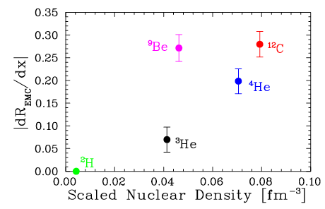
Seely et al. 2009 Phys. Rev. Lett. 103 202301
Showed that it may be the local density, not the average density that causes the modification
If the EMC effect scales with the local density, the Deuteron will experience an EMC effect

Slide 5
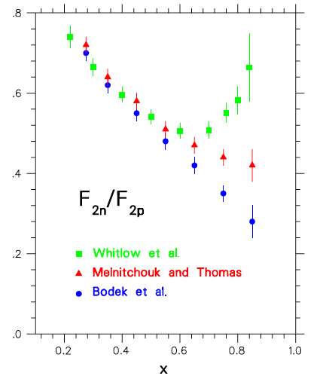
Importance of
not well know in the
region x > 0.6
More accurate and
ratios at high x will
help to test various
models & predictions
as
Determine magnitude of EMC effect in the Deuteron

Slide 6
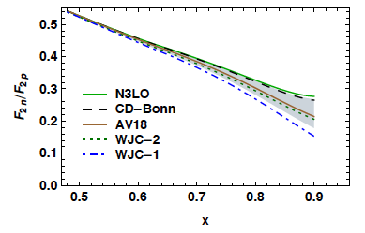
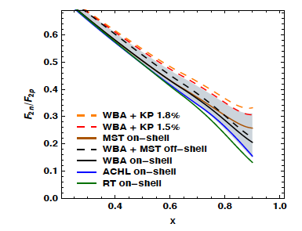
Difficulties of extracting
Model 1*: Relativistic vs. Non Relativistic Deuteron Wave function
Major Challenge
No free Neutron Target
Extract using nuclear targets
Inclusive scattering to measure
is highly model dependent
Deuteron wave function
Smearing function
Off shell correction
Model 2*:Off-Shell vs. On-Shell
*J. Arrington, J. G. Rubin, and W. Melnitchouk, Phys. Rev. Lett. 108 (2012) 252001

Slide 7
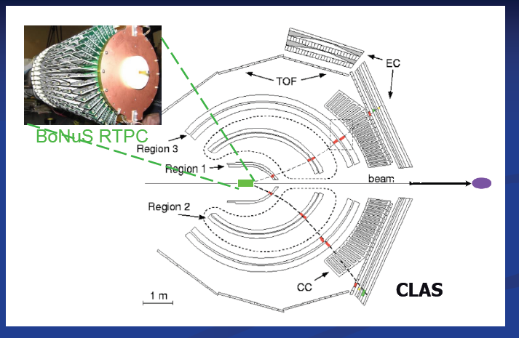
BoNuS (“Barely Off-shell Nucleon Structure”)
Semi inclusive scattering
Spectator Tagging
Detect slow recoiling Protons (70 -150 Mev/c)
Reduces off-shell corrections
Momentum of recoil proton allows for better constraint on struck neutron motion
Reduce/Eliminate the Fermi Smearing effects

Slide 8
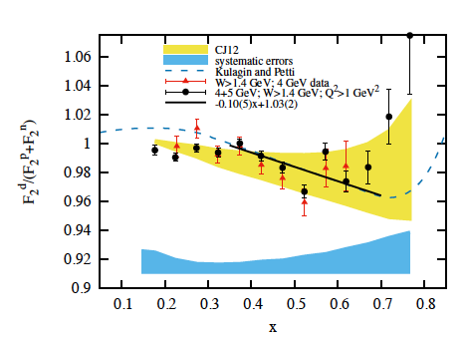
BoNuS Results
If the Deuteron is just a free neutron and proton then:
Data does not support this picture
Deuteron EMC ratio vs. x*

Slide 9
Conclusions
Need a model that
Includes nuclear corrections: Fermi motion, nuclear binding, off-shell corrections, deuteron wave function
AND
Matches new Experimental data (BoNuS)
Examples
CJ12*
S.A. Kulagin and R. Petti^
*J. Owens, A. Accardi, and W. Melnitchouk, Phys. Rev.D87, 094012 (2013), 1212.1702
^S. A. Kulagin and R. Petti, Nucl. Phys. A765, 126 (2006), hep-ph/0412425.

Slide 10
Thank You!

Slide 11
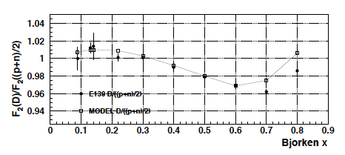
Comparison
BoNuS +CJ12 (Yellow)
S. A. Kulagin and Petti

Slide 13
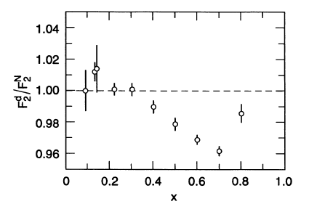
Comparisons
Nuclear Density (SLAC)
BoNuS
S. A. Kulagin and R. Petti

